Slide 1

(RE)Introduction to gorilla
Rebecca Norman (rebecca.norman.19@ucl.ac.uk)

Slide 2
Overview
What is Gorilla?
Setting up an account
Creating a project
Creating a questionnaire
Creating a task
Building an Experiment

Slide 3

What is Gorilla?
Gorilla is an online research platform designed to allow researchers to create and deploy behavioural experiments
  Gather accuracy and reaction time data
Three main features:
  Questionnaire builder
  Task builder
  Experiment builder
Notes:
Task builder 1 is now legacy, this presentation will focus on task builder 2, which you may not be familiar with.

Slide 4
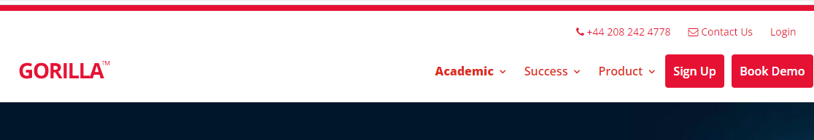
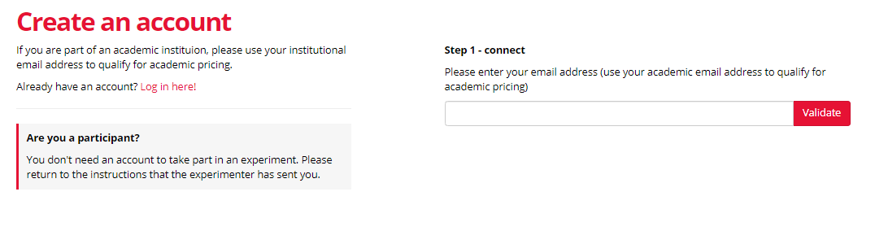
Creating a gorilla account
The first thing you need to do is create a Gorilla account if you don’t have one already
Go to gorilla.sc and click ‘Sign Up’
On the next screen, enter your UCL email address and click ‘Validate’
  UCL has an agreement with Gorilla which covers the fees
Follow the steps in the email to create your account

Slide 5
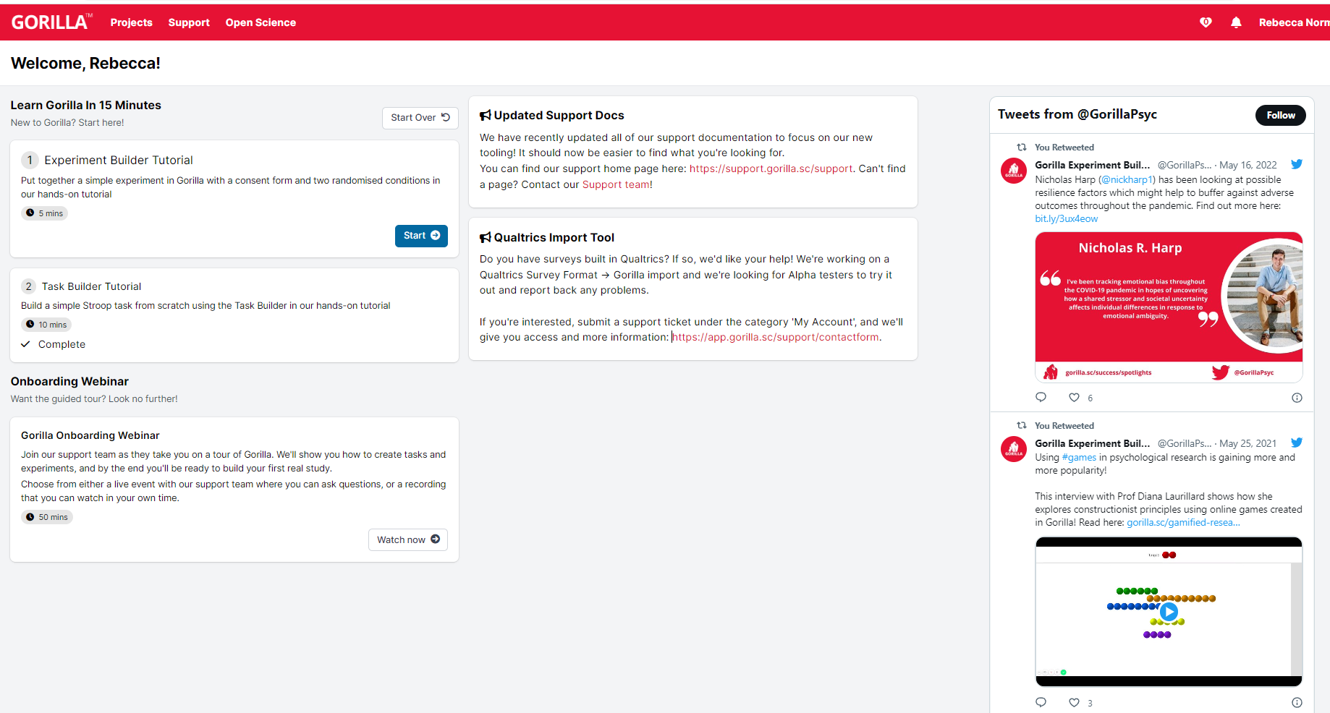
Gorilla Home Screen
This is the landing screen you see when you first log in to Gorilla
On the left hand side there are links to basic tutorials which explain how to get started in Gorilla
At the top of the screen you can access your projects, which is where any experiments or tasks you build are kept

Slide 6
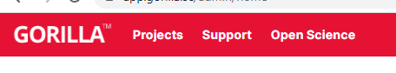
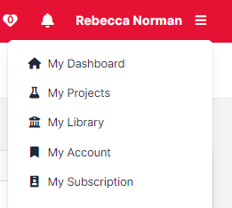
Creating a project
The first thing you need to do to begin creating your experiment is to create a project
This is very straightforward:
  From the home screen click “projects” on the top of the screen, or “my projects” from the dropdown menu next to your name on the right

Slide 7
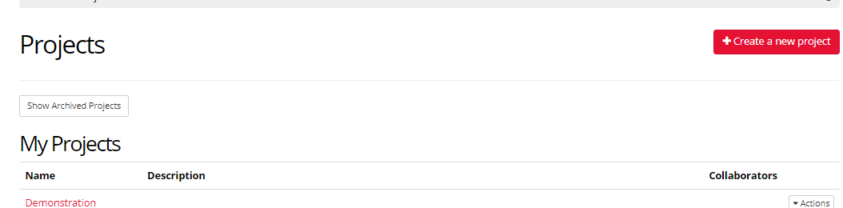
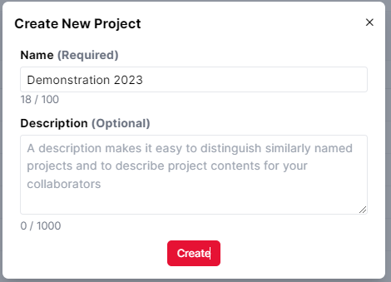
Creating a project
This will take you through to the Projects landing page, where you can see any projects you are working on
  Click “create new project” in the top right corner
  Name your project, click Create
  You can add a project description if you think this might be helpful
You are now ready to start assembling the components of your experiment!

Slide 8
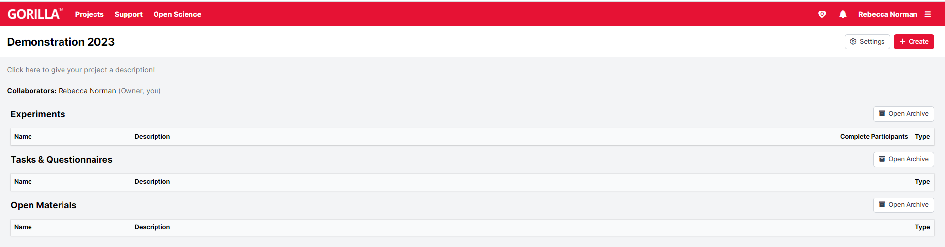
Project home page
Notes:
This shows the home page for your project. Here you will be able to see any experiments you construct, and the tasks and questionnaires you create to build these.

Slide 9
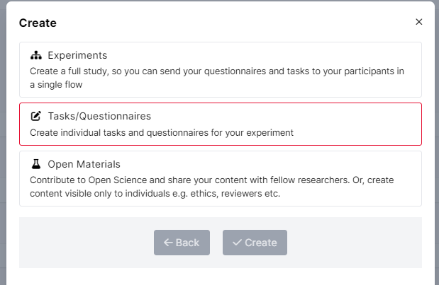
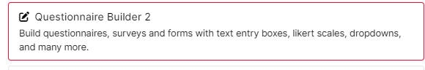
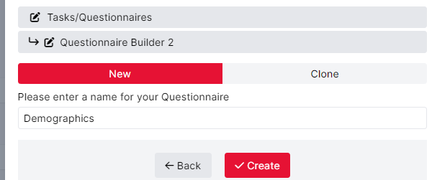
Creating a Questionnaire
Creating a simple demographics questionnaire
  You will want to screen participants against your inclusion criteria
Create -> Tasks/Questionnaires
Questionnaire Builder 2
Enter name -> Create
Notes:
First we’ll look at creating a questionnaire. All studies will require collection of some sort of demographics information, so you will want to ask your participants some basic demographics questions. We’ll base this questionnaire on that. If you go back to the previous slide, you will see that there is a button in the top right corner which says ‘create’. We want to click this, then select tasks/questionnaires then questionnaire builder 2 to begin building our questionnaire. Gorilla will then give you the option of creating a new questionnaire or cloning an existing one. We want to create a new questionnaire. You then name your questionnaire and press ‘create’.

Slide 10
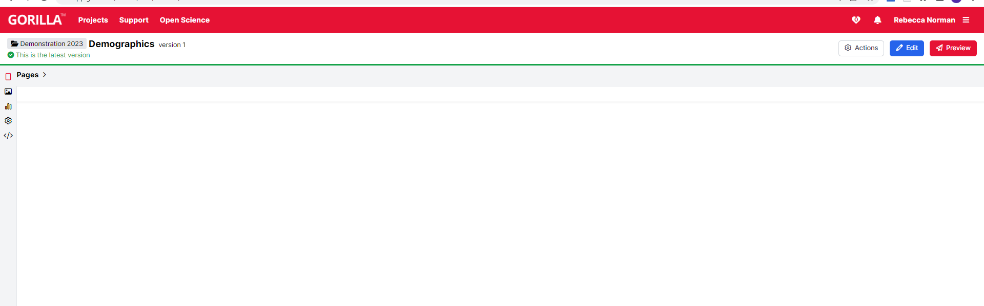
Questionnaire builder
Notes:
This shows the questionnaire builder interface. Questionnaires are made up of ‘Pages’ to which we add ‘objects’ to build the questionnaire. Click ‘Edit’ in the top right corner to begin building your questionnaire.

Slide 11
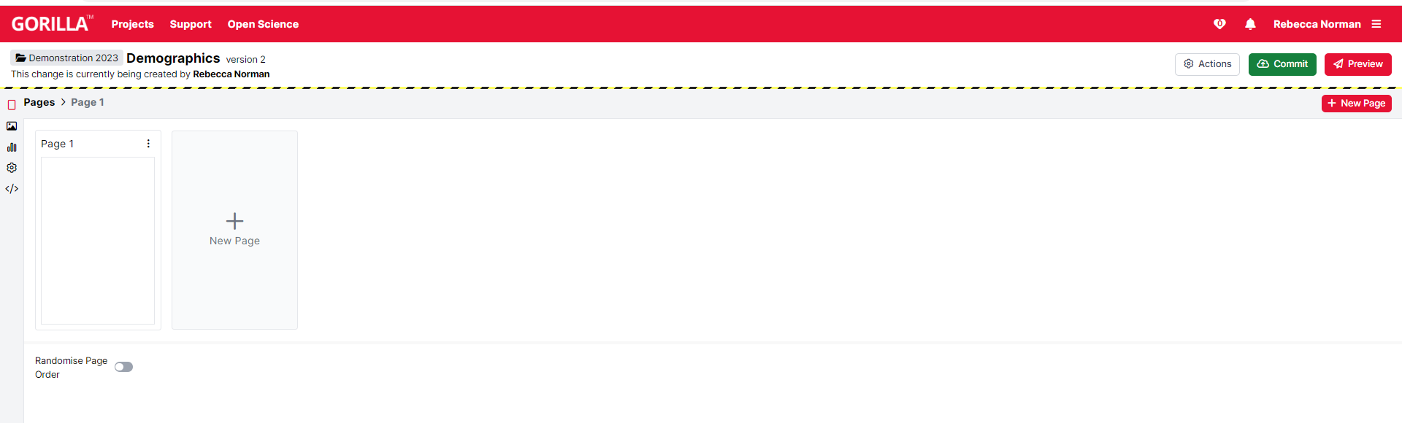
Questionnaire builder
Notes:
This shows all the pages of your questionnaire. Click on ‘Page 1’ to begin creating a questionnaire

Slide 12
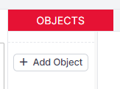
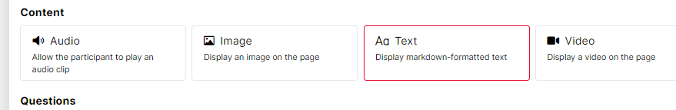
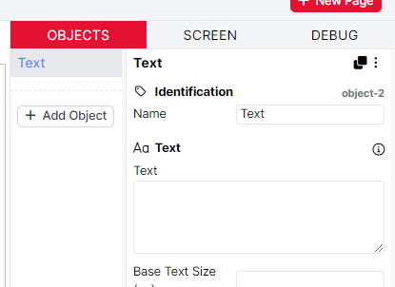
Creating a Questionnaire
Add Object -> Text -> Create
  Allows you to write instructions
Type instructions in the box on the right hand side of the screen
  Can format using markdown
    https://app.gorilla.sc/support/markdown
  Or HTML
    https://support.gorilla.sc/support/html
Notes:
The first thing I want to do is to give my participants some instructions, introducing the experiment and the questionnaire. To do this, I add an object, under the ‘objects’ tab on the right hand side of the interface. I’ve chosen the ‘Text’ option as it will allow me to format the text using either Markdown, HTML or a combination of both.

Slide 13
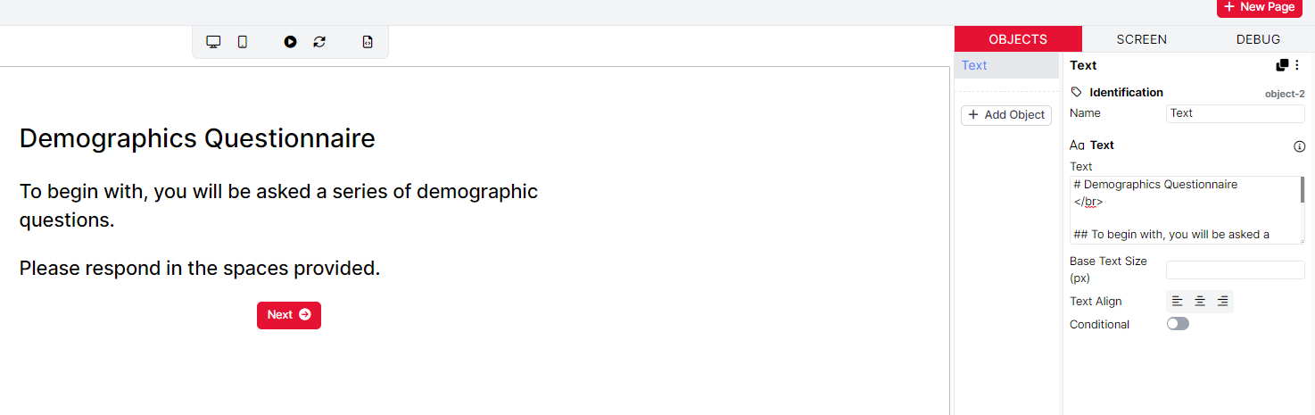
Creating a questionnaire
Notes:
Here I have typed out the instructions in the Text object, used Markdown to format the text and HTML to add line breaks. On the left you can see how this will look to participants

Slide 14
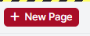
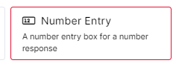
Creating a Questionnaire
New page
Number entry: allows participants to enter values
  Not always convenient to use a drop down menu
  E.g. exact age
Add object -> Number Entry -> Create
Notes:
let’s add some questions. We want these to be separate from our instructions, so click new page in the top Right hand corner. Now, to add some questions. There are two basic question types we will cover here: number entry where participants can enter any numeric value and multiple choice, where they select an answer from a series of options. First we’ll look at number entry, as we want to ask participants their age. To add a number entry question, Add Object, Number Entry then Create.

Slide 15
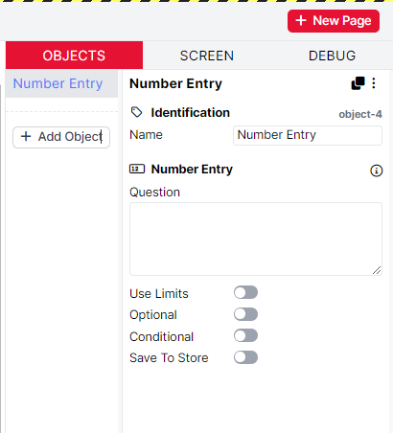
Creating a Questionnaire
Identification
  Name the object something useful
Object Type
Use Limits
  Set minimum and maximum values
Optional
  Allows participants to skip the question
Conditional
  Answer only when certain conditions are met
Save to Store
  Saves responses as embedded data
  Allows you to branch participants according to their answers
Notes:
This gives you an object with the following options (from slide)

Slide 16
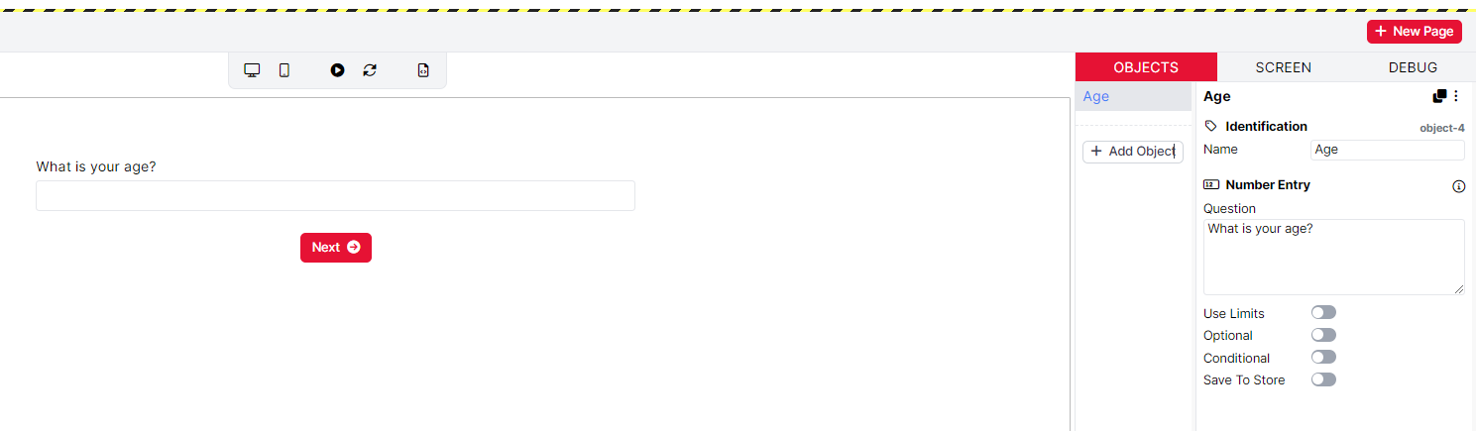
Creating a Questionnaire
Notes:
Here I have renamed the object as ‘Age’. This is what responses will be saved under in the spreadsheet generated at the end of the experiment. I have typed in my question, and you can see how this will look on the left hand side. I also want this question to be compulsory, so I have left optional off. This procedure is the same if you want to include text entry (select the Text input object for short answers and the comment box object for longer answers).

Slide 17
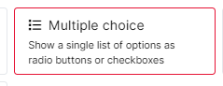
Creating a Questionnaire
Multiple choice: allows participants to select a vale from a list of options
  Good for options with binary options or few values
  E.g. sex, education level
Add Object -> Multiple Choice -> create
Notes:
The next question type we will cover is multiple choice. Like with number entry, we create a multiple choice question by clicking add object but now selecting multiple choice.

Slide 18
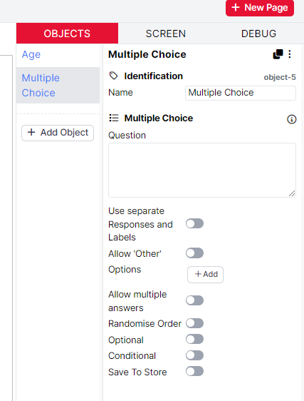
Creating a Questionnaire
Options
  List of the options available to choose from
Allow ‘Other’
  Provides an ‘other’ option with a text entry box
Allow multiple answers
  Allows participants to select more than one option
Randomise Order
  Randomises the order of response options
Notes:
This gives you an object with the following options DESCRIBE AS ON SLIDE

Slide 19
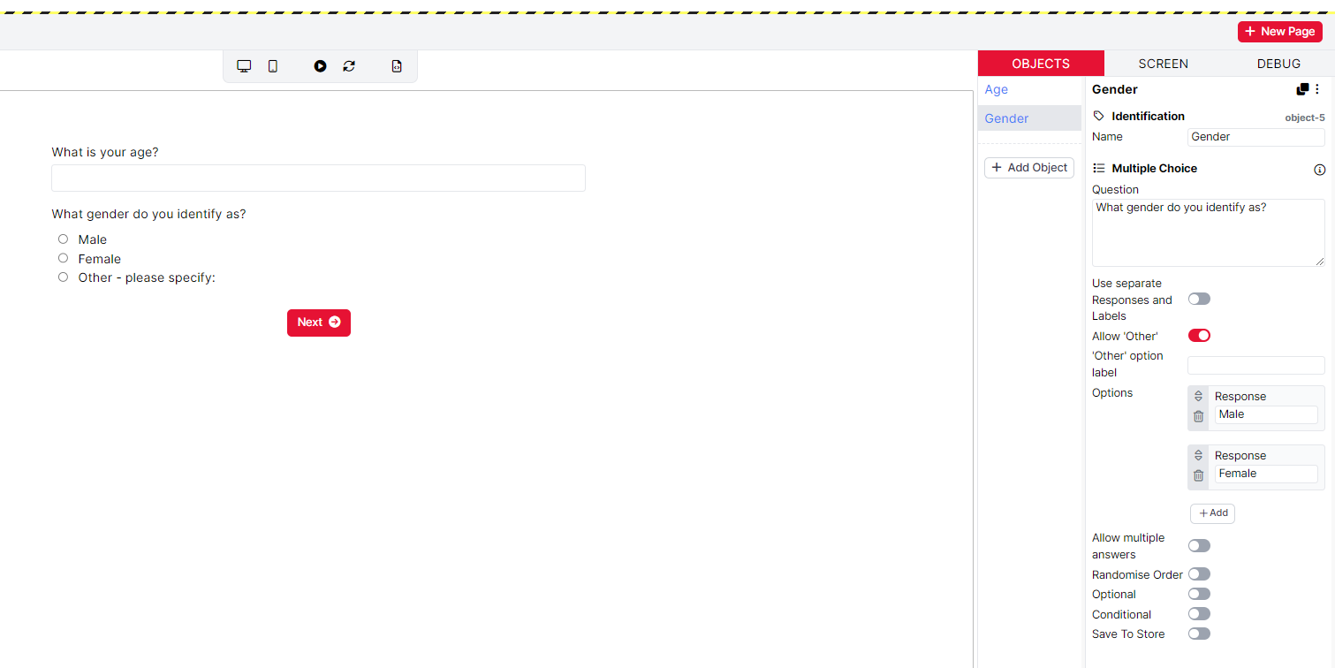
Creating a Questionnaire
Notes:
Here is what it looks like filled out. I’ve gone with asking about gender. I have added Male and Female as my options, and have selected ‘allow other’ which, if selected, will display a text box where participants can enter an alternative answer.

Slide 20
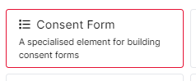
Creating a Questionnaire
Consent box
  Displays a box participants for participants to check
  Used when getting informed consent
Add Object-> Consent form -> Create
Notes:
Final thing I will cover is consent boxes. Again, we simply add a new object for these.

Slide 21
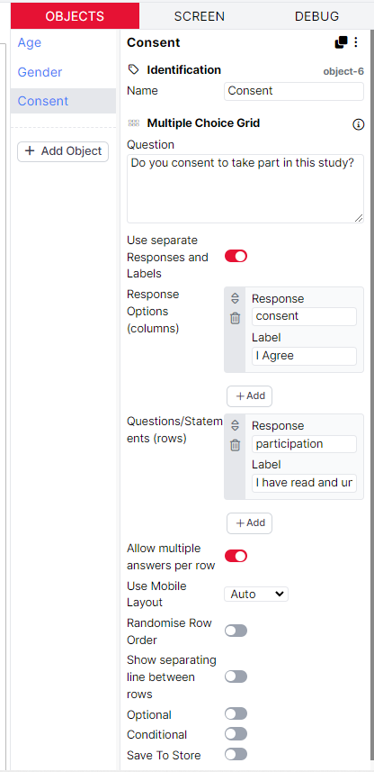
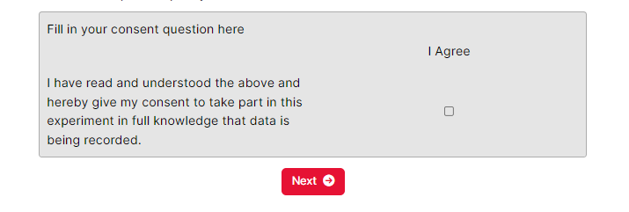
Creating a Questionnaire
Notes:
Gorilla automatically generates some consent text a check box to indicate if participants agree or not. When we look at the consent Object in the objects tab, we also see that ‘use separate responses and labels’ has been selected allowing the consent statement to appear on the left hand side next to the response.

Slide 22
Creating a Questionnaire
You can repeat these steps to create as many questions as you need
When you are done, hit ‘Commit Version 1’ to save your questionnaire
If you want to change something, Gorilla will save this as a separate version, so you can easily retrieve previous ones
  You will be prompted to describe your changes, so it’s easy to keep track of changes made throughout your project
For more information:
  https://support.gorilla.sc/support/tools/questionnaire-builder-2
Notes:
Now you just repeat these steps as many times as necessary to build your questionnaire. When you are done, hit commit to save your changes

Slide 23
Creating a Task
You can program experimental trials using the ‘task builder’ or more recent ‘task builder 2’ in Gorilla
I will be using task builder 2 here
Gorilla provides a lot of support and even a walkthrough to help you get started, which I would recommend looking over:
  https://support.gorilla.sc/support/reference/faq/task-builder#overview
  https://support.gorilla.sc/support/tools/task-builder-2
Notes:
The next thing you need to know is how to create your experimental task in Gorilla. This uses the task builder or task builder 2. Again, Gorilla has detailed guides on how to use this which I recommend looking over. Here I’ll demonstrate how to use task builder to create a simple lexical decision task in task builder 2.

Slide 24
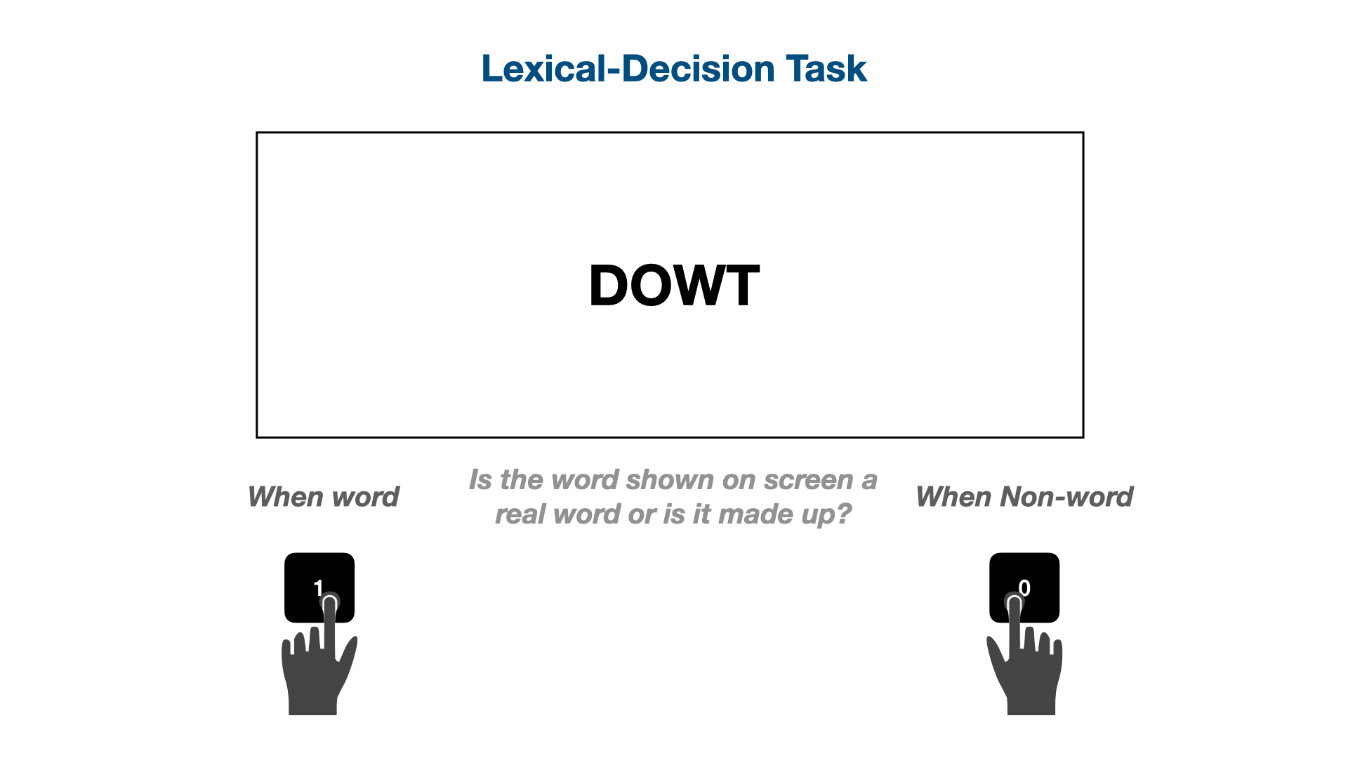
Lexical decision
The task I will be programming to demonstrate the functionality of Gorilla is a Lexical Decision task
Lexical decision: decide whether a character string on screen is a word – or not
Commonly used in studies of word processing
Notes:
The task I will be creating in this demonstration is a lexical decision task. This is commonly used in behavioural studies of word processing. In these tasks, participants are asked to decide whether a character string on screen is a real word or a made up ‘pseudoword’. For this task, we will be asking participants to use a keyboard press to indicate whether the character string they see is a word or not.

Slide 25
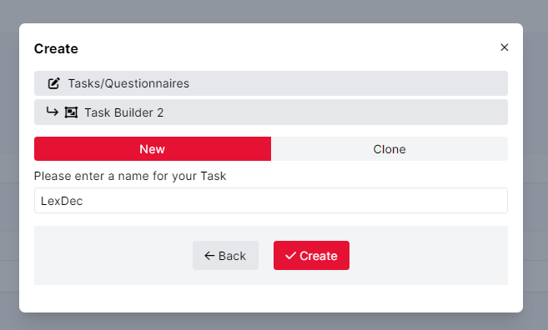
Creating a Task
Create -> Tasks/Questionnaires -> Task Builder 2
Name your task and click ‘create’
Notes:
The first thing you need to do is create a task. Go back to the projects home page, select ‘create’ , tasks/questionnaires, task builder 2. Name your task and click create.

Slide 26
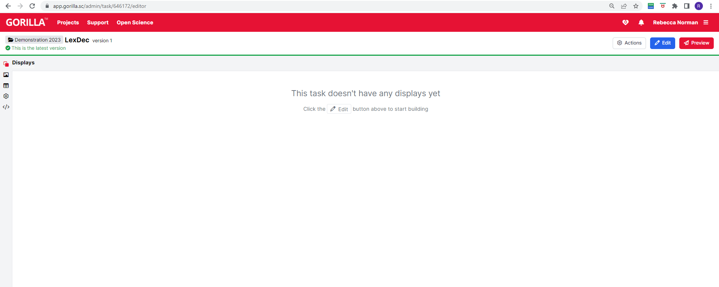
Creating a Task
Notes:
This shows the basic task builder interface. Tasks are made up of ‘displays’, so let’s hit edit and look at this in more detail.

Slide 27
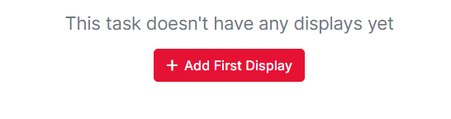
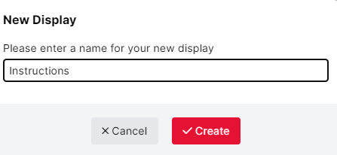
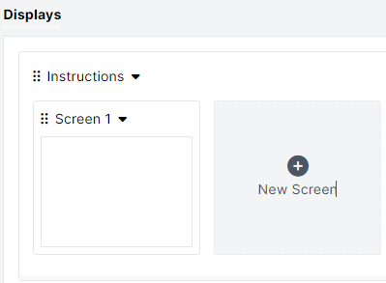
Creating a Task
Tasks are made up of ‘Displays’ and screens within these
To add a new display- click Add first display(top picture)
Name your display and click Create
This generates a display with one screen
  We can then add screens to this display by clicking new screen
Notes:
Tasks are created by building a series of ‘displays’. Add a new display by clicking the Add First Display. I am going to call this first display ‘instructions’ and create a screen that will tell the participants the instructions for the task. Gorilla automatically generates one screen in the display, so we’re going to click on this.

Slide 28
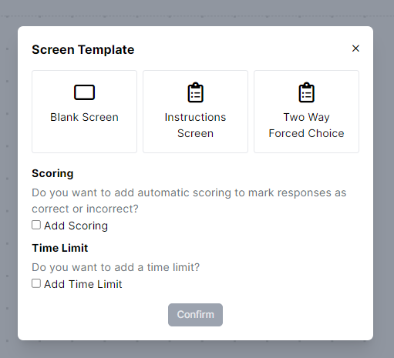
Creating a Task
We are then presented with a series of template options.
For the instructions, I will select Instructions Screen
I don’t need it to record scores or have a time limit so I’m going to leave these options blank
Notes:
This brings up a selection of templates we can use to structure our screen. I will select instructions screen.

Slide 29
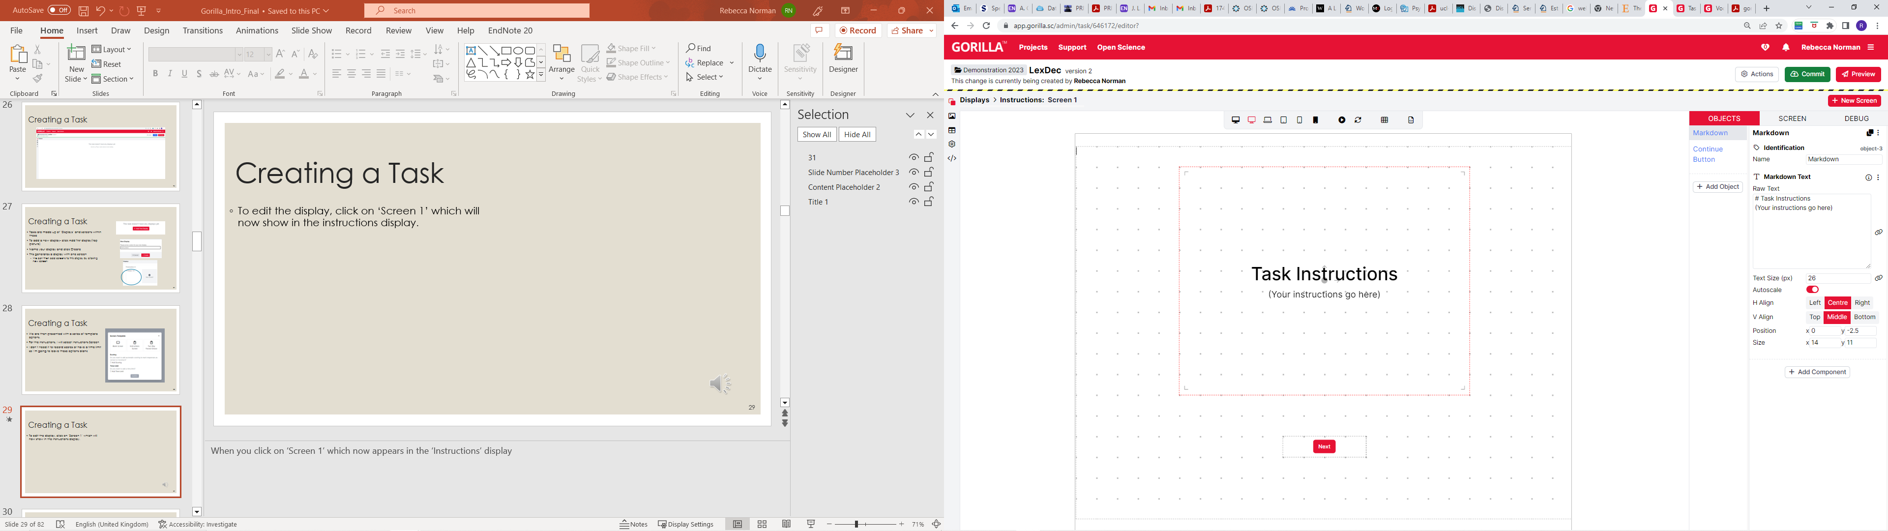
Creating a Task
This brings up the following interface

Slide 30
Creating a Task
In the objects tab we can type out our instructions in the Markdown Text box
Like questionnaires, we can use markdown and html to format our text
  You can also use the text size option to resize the text, and H align and V align to change the position.

Slide 31
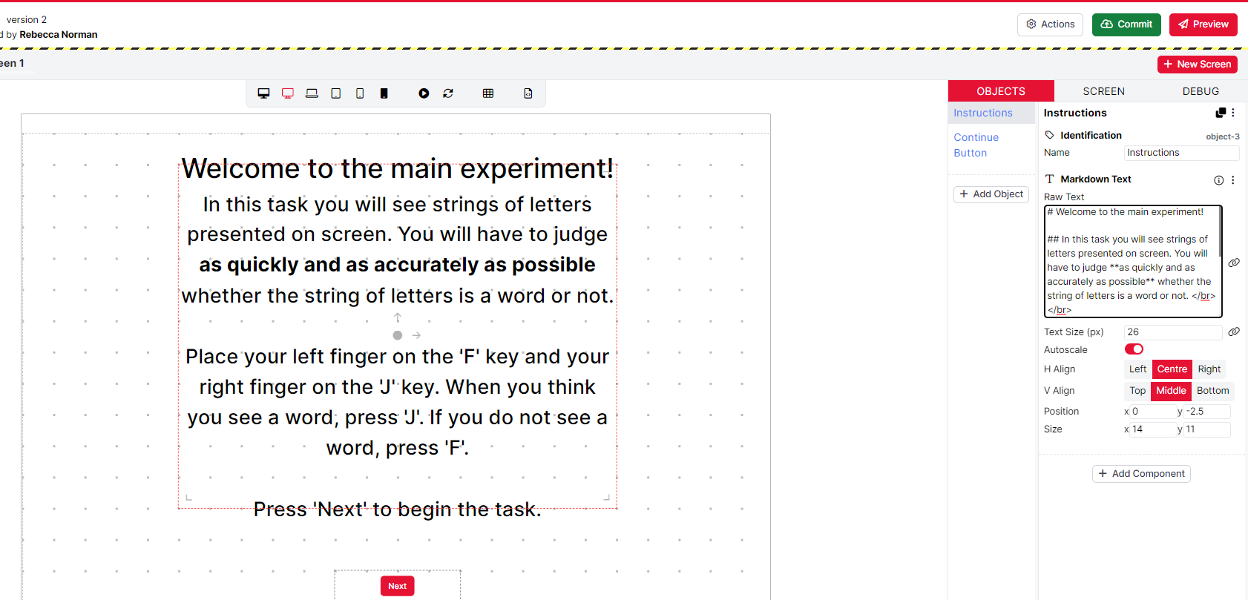
Creating a Task
Notes:
Here I have written out some simple instructions for a lexical decision task using markdown to format the text. If you want, you can alter the layout of the task elements by dragging them around the preview space on the left of the screen
Click OK to write the changes.

Slide 32
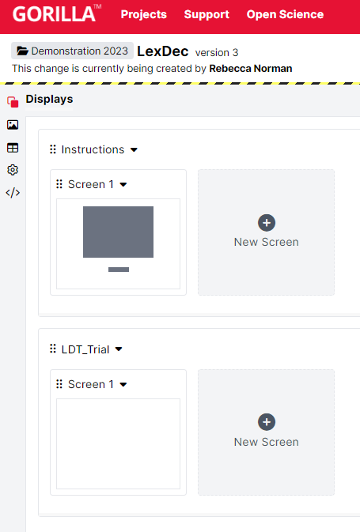
Creating a Task
Creating trials
Want 2 parts, fixation cross and trial
Create a new display by clicking Edit, then New Display
  Name this, press Create
  Now we have another display underneath our instructions
Notes:
The next thing to do is to create a second display where you set up your experimental trial structure. For this task, we want 2 elements: a fixation cross and a screen which displays the character string about which participants make the word/pseudoword decision. Create a new display after the Instructions by clicking edit then new display. Name this something logical, I have gone with LDT_Trial.

Slide 33
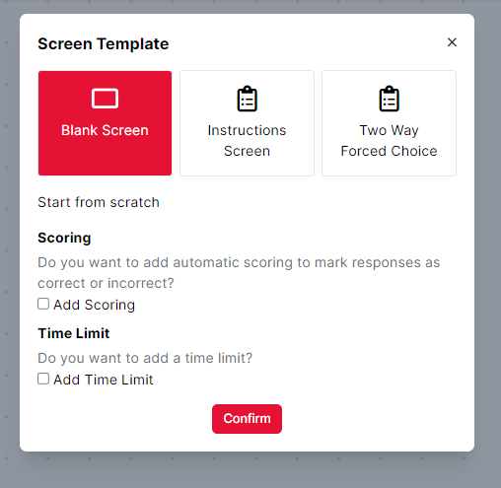
Creating a Task
Now we need to add screens that correspond to the elements of our trials
For the fixation cross, click on screen 1 and select blank screen
I’m going to leave scoring and time limit off for now
Notes:
The first thing we want to be displayed to participants is a fixation cross. There is no initial template for this so I’m going to select blank screen.

Slide 34
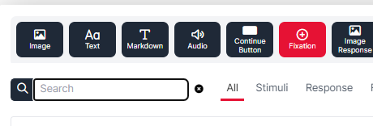
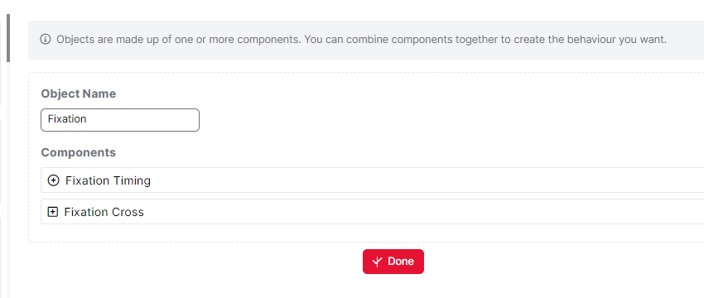
Creating a Task
To add a fixation cross, select Add Object -> Fixation
This has 2 components, Fixation Timing and Fixation Cross
  Objects in Gorilla are composed of components. You can add/remove these to customize different aspects of your experiment
Click ‘done’ to return to the screen editor

Slide 35
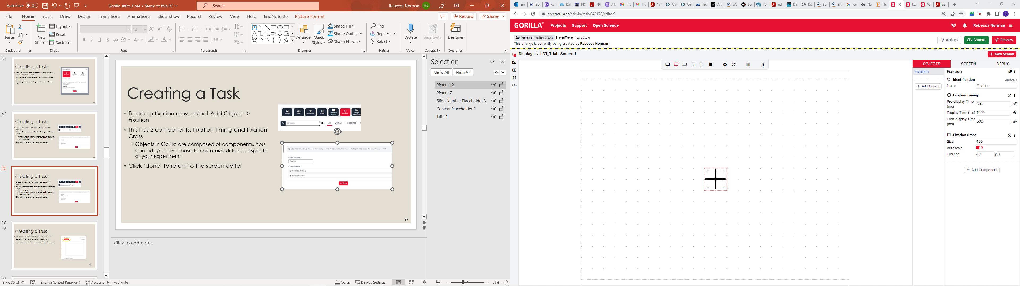
Creating a Task
The left screen shows how the display will look to participants
To the right we have different settings for the timing of the fixation cross
  Pre-and post display time are how long a blank screen is displayed either side of the cross
  Display time is how long the cross is on screen for
  Size allows you to toggle the size of the cross
I’m going to change the settings so the cross displays for 500ms with 200ms of blank screen either side

Slide 36
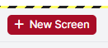
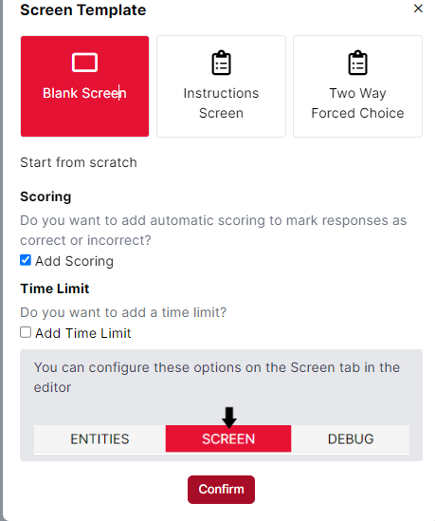
Creating a Task
Now I want to create the main lexical decision task
To do this, click new screen in the top right hand corner
Again I have selected Blank Screen, but this time I have selected Add Scoring as I want to register whether participants responded correctly
I can change the settings for this in the ‘screen’ tab later
Notes:
Once you have selected Blank you will be presented with a screen layout panel like the Introduction screen. Too add elements to the screen, click ‘Add Object’

Slide 37
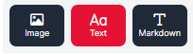
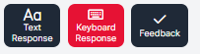
Creating a Task
I need two elements for each trial:
  The word/pseudoword to be displayed
  An object which registers participant responses
For the word/pseudoword stimuli, we add an object then select ‘text’
For the response, we add an object then select ‘keyboard response’
Notes:
We add elements for each trial by again clicking add object under the objects tab. We need two elements for each trial – the word/pseudoword to be displayed and another that registers keyboard responses.

Slide 38
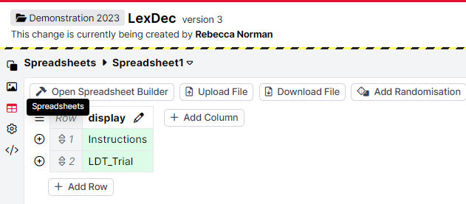
Creating a Task
For our word stimuli, I want Gorilla to use values from a spreadsheet.
Tasks in Gorilla rely on data read in from spreadsheets
You can either create one of these in Gorilla or upload your own
Key Information:
  Display: which one of your displays the row corresponds to
  Item: the item to be displayed
  Correct Answer: what is the correct answer
You cab access your spreadsheets linked to a project under the spreadsheets tab on the left hand side of the task builder interface
Notes:
For our word stimuli, I want Gorilla to take the values from a spreadsheet. Tasks in Gorilla rely on data read in from spreadsheets, which you can either create yourself or upload. I’m going to show you how to create a spreadsheet in Gorilla.

Slide 39
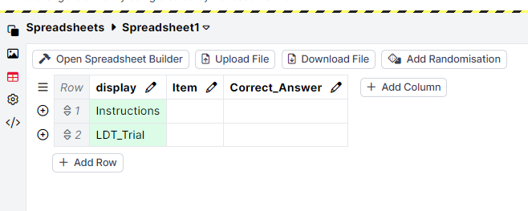
Creating a Spreadsheet In Gorilla
You can create a spreadsheet in Gorilla, or upload one of your own
To create on in Gorilla, add columns corresponding to display (display to show), item (stimulus to show) and answer (correct answer)
  Note that display is added automatically
  You can also add columns which dictate experimental manipulations such as randomization (more on this later)
Notes:
For this I’ve created the spreadsheet within Gorilla. The display column is input automatically by gorilla, but I have added two others which will tell it what word to display on each trial and the correct answer.

Slide 40
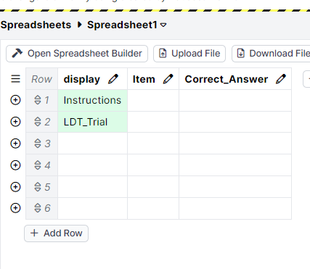
Creating a Spreadsheet In Gorilla
You now need to add rows to your spreadsheet
Click ‘Add Row’
Here I’ve added 4 Rows
Gorilla has already populated the ‘display’ column of the first two rows
The first Row is instructions.
  This will show the instructions display at the start of the experiment
The second is LDT-Trial
  This will show the trial display
Notes:
Now I need to populate the spreadsheet. I click + by ‘Row’ and then ‘Add Row’.

Slide 41
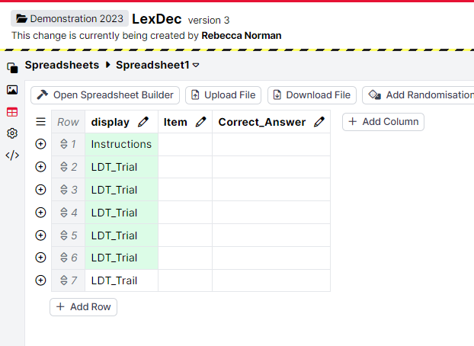
Creating a Spreadsheet In Gorilla
In the next 4 rows, I have put LDT_Trial, telling Gorilla I want the LDT_Trial display shown 4 times
When the spreadsheet is linked to the display, it is highlighted in green
  Note that the 5th row has been spelled incorrectly and is not highlighted
Notes:
Here I’ve added 5 rows. In display for the first one, I’ve put instructions. This is because I want the instructions displayed at the start of the experiment. For the other rows, I’ve entered LDT_Trial which tells Gorilla to show the trial display 4 times. Note that these are highlighted in green – this shows that the spreadsheet is connected to the nominated display. The last row, where I have entered the wrong display name is not highlighted, showing that Gorilla doesn’t recognise it and it is not linked up

Slide 42
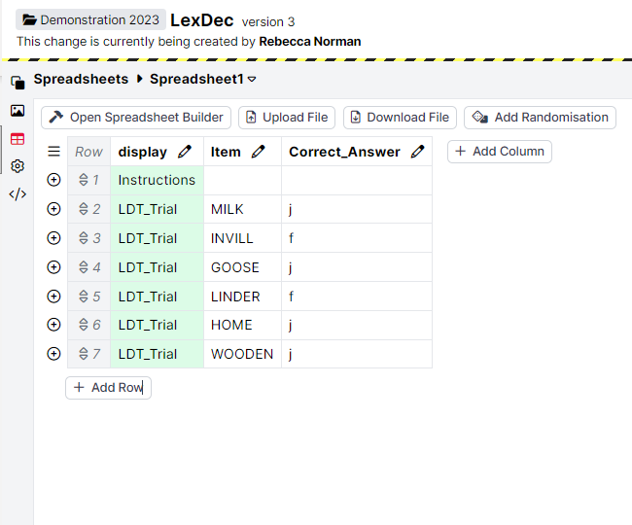

Creating a Spreadsheet In Gorilla
We need to tell Gorilla what to show, and the correct answer.
I have typed some words and pseudowords in the Item column
I have told Gorilla what the correct key press is in the Correct_Answer column
  J for word
  F for pseudoword
Notes:
Let’s add some more information. In the ‘Item’ column I’ve got some words and pseudowords. In the ‘correct answer’ column, I’ve told Gorilla the correct key press.

Slide 43
Uploading a spreadsheet
Alternatively, you can upload a spreadsheet from excel
Just make sure the rows correspond to your display names, and the column headings to your objects!

Slide 44



Creating a Task
OBJECTS -> word
Next to the text box, click the bind symbol
Under the use the value in this spreadsheet column dropdown, select ‘Item’
Click bind
The green S tells us that the spreadsheet and the display are successfully linked
  Note that I have also changed the text size
Notes:
Let’s go back to our lexical decision task by clicking the Displays icon at the top of the left hand menu. In the text object (renamed word here), we can now tell Gorilla to retrieve the value to display by ‘binding’ the object to the spreadsheet.

Slide 45


Creating a Task
Now we want to record our participants responses
In the ‘response’ object, I have told Gorilla what key presses I want to record, and what I want these to map onto for the scorer
  Remember the key presses specified in the spreadsheet were lower case
Under the screen tab, I have used the scorer component to record whether participants were correct or not
  I have bound it to the correct answer column, basically this tells the scorer to match the response to the value in the spreadsheet
Preview the task to check it is working correctly
Notes:
We record participants’ responses using the Response object. Here I have told Gorilla what each key press maps onto in the spreadsheet. In the screen tab, I have added a scorer component to tell Gorilla what the correct answer is from the spreadsheet.

Slide 46



Creating a task
If you want to randomise your trials, create a new column called ‘randomise_trials’ and populate it with 1 in each row
Click Randomisation -> Add Component -> Randomise Trials -> Choose
Select randomise_trials as the column
Notes:
You might want to randomize your trials. To do this, enter 1 in a randomise trials column, then use the ‘randomisation’ feature to randomize trials based on this.

Slide 47

Creating a task
You might want to include breaks for your participants if you are conducting a longer experiment
To do this create another display
Select a screen template – I’ve gone with instructions screen again and just edited the markdown text
Notes:
If you are conducting a longer experiment, you might want to build in breaks for your participants. To do this, we create another display, here named ‘Break’. I have used the instructions template for this and have edited the text to inform participants they have an optional break

Slide 48

Creating a task
Inserting a break into the experiment
Add a new row where you want the break to be
Type the name of your break display in the display column
Gorilla will then display it at this location when you run the experiment
Notes:
Lastly, add a row in the spreadsheet where you want the break to be, in this case after 7 trials. Typing ‘Break’ in the display column tells Gorilla to display the break screen at this point.

Slide 49
Creating a task
Practice trials
You might want to include some practice trials before the task begins to make sure your participants understand the instructions
Add a new display, select blank display
Notes:
You might also want to include some practice trials at the start of your experiment. Create another display

Slide 50
Creating a task
I want to create 2 practice trials: 1 for a word and 1for a pseudoword
I want these to mimic the experimental trials, BUT with the addition of feedback
So these will consist of 4 Objects:
  Fixation cross
  Word to be displayed
  Keyboard response
  Feedback
Notes:
In this example I’m going to create 2 practice trials, one for a word and one for a pseudoword. We want these to mimic the structure of the experimental trials (fixation cross followed by a character string on screen), but with the addition of feedback.

Slide 51

Creating a task
For my first screen I want a short introduction to the practice trials to separate them from the main experimental task
To do this, I have simply added a Markdown text object and typed some simple instructions using Markdown to format
I have also added a continue button
  Add Object -> Continue Button
Notes:
First I have created a short introduction to differentiate the practice trials from the main experiment.

Slide 52

Creating a task
These trials are not linked to a spreadsheet and are the same for all participants
For the first practice trial, we create a new blank screen and add scoring
We add three objects:
  Text
  Keyboard Response
  Feedback

Slide 53
Creating a task
These trials are not linked to a spreadsheet and are the same for all participants
Type word into the text box instead of binding it to a spreadsheet
Notes:
These practice trials are not linked to the spreadsheet, so type the word to be displayed in the text box.

Slide 54

Creating a task
Here we see that I’ve decided to create the word practice trial first, and have gone with ‘burrow’
  I have typed this in all caps and changed the font size to mimic the main experiment
I have changed the mappings in the keyboard response section to the same as those in the main experiment

Slide 55

Creating a task
As these trials are not linked to the spreadsheet, I have manually specified what the correct answer is in the scorer component under the screen tab
  The correct response is j as this is a word trial
The feedback object will use this to determine whether the response was correct or not, and provide feedback based on this. We don’t have to do anything else with the feedback object.
Repeat for the nonword practice trial
  Remember to set the correct answer in the scorer to f!

Slide 56

Creating a task
Now we need to add in fixation crosses between practice trials
I created two fixation crosses in the same way described earlier
I then went back to the ‘displays’ screen and used clicked on the six dots in the top left corner of the screens to reorder them by dragging them into the correct position
Notes:
You can rearrange the order of screens by dragging them into position using the 6 dots in the left hand corner of the screen

Slide 57

Creating a task
To finish off the practice trials, I want to add a screen telling participants they’ve finished
I am going to select instructions screen again
However, instead of click to continue I want participants to press a key to advance
  Add object -> control -> Key To Continue
Notes:
So, we have now created some practice trials, but we won’t want these to run straight into the main experiment. You can create a screen to end the practice trials using the same method we used to create the introduction slide, or you can build a custom one which might be a good idea if you want to change the way participants continue the experiment, rather than clicking next. Here I have done that by adding a new Object, going to control, then key to continue.

Slide 58

Creating a task
I have added some simple instructions as before
In the Key To Continue -> Key text box I have specified ‘space’
Notes:
Now I have a key to continue object instead of a continue button. I need to tell Gorilla the correct key press, and have specified the space bar here

Slide 59

Creating a task
Remember to add a row in the spreadsheet for the practice
Notes:
Now, add a row to the spreadsheet telling Gorilla where you want the practice trials to be shown.

Slide 60

Creating a task
Finally, you’ll want to tell your participants that they’ve finished the task, and thank them for their time
Create a new display for the end screen
I want to add a timelimit for this, so I’ve created a blank screen and added a time limit
Notes:
The last thing you will probably want to add is an end screen, informing participants that they have completed the experiment and thanking them for their time. Create a display, give it a sensible name and create a new screen. Again, you can just go for the blank screen here. For this exercise, I have added a time limit so instead of having participants determine when they move on from the screen, there is a time limit for how long it is shown for. When this runs out, the screen will move on automatically.

Slide 61


Creating a task
We now have a section for timelimit in SCREEN tab
Here you can alter how long the screen is displayed for
I have told it to move to the next screen after 5 seconds
Too add a visible for a countdown timer add a Countdown object under the objects tab
Remember to add a row at the end of the spreadsheet corresponding to the End display
Click ‘Commit’ to save your changes
Notes:
Now when I look at the SCREEN tab for this screen I have a component called ‘Time limit’. Here you can determine how long the screen is shown for (here it is 5 seconds or 5000ms). I want to add a timer which shows participants how long they have left, which I do by adding a countdown object under the objects tab. I then need to add some text (add object, markdown text) to tell participants they have finished the experiment. Finally, I add a row at the end of my spreadsheet and type the display name to tell Gorilla to display this at the end of the experiment.

Slide 62

Putting it together
Returning to the Projects interface you will now see the task and questionnaire we have created displayed under tasks and Questionnaires
We now need to bind these into an experiment
Guidance on how to do this can be accessed here:
  https://support.gorilla.sc/support/reference/faq/experiments#overview
Notes:
Now you have created your questionnaire and basic task it’s time to put the two together into an experiment. Go back to the projects home page, and you will see the questionnaire and the lexical decision task under ‘Tasks and Questionnaires’. We want to bind these together into an experiment using the experiment builder.

Slide 63

Putting it together
The first thing to do is to create a new experiment
Select ‘Experiments’ from the Create menu
Then select Experiment builder
Name this, press ‘Create’
Notes:
To create an experiment, on the projects home page, click ‘Create’ , then experiments then experiment builder.

Slide 64

Putting it together
This is what the basic experiment tree starts off as
We have two connected ‘Nodes’; start and finish
Notes:
This is the basic experiment builder. Right now, the experiment tree only consists of a start and finish. To start adding components click ‘edit’

Slide 65

Putting it together
Experiments are constructed using ‘Nodes’
We want to add Nodes for our task and our questionnaire
Click on add new node
Notes:
Tasks and questionnaires are added as ‘Nodes’. Click ‘Add New Node’ to begin adding components.

Slide 66

Putting it together
This brings up the Choose New Node Menu
Select questionnaire to add a questionnaire
Notes:
This will bring up the following menu, which shows the various types of nodes you can add in to your experiment. The first thing we want to add is our demographics questionnaire, so I have selected ‘Questionnaire’.

Slide 67

Putting it together
This then displays a window showing all available questionnaires
Select Demographics, click OK
Notes:
This takes us through to this screen which shows all available questionnaires, in this case ‘Demographics’.

Slide 68

Putting it together
We now have a new node for our demographics questionnaire
We add this to the main experiment by dragging the arrow from the Start node to the questionnaire node
Then clicking on the white circle to draw an arrow from the demographics node to the finish node
On the next slide there is a video demonstration of this
  This also shows how we add Task
Notes:
Now the demographics questionnaire has been added as a new node. The next slide shows a video of how we add this into the experiment tree

Slide 69

Notes:
I repeat the same steps to add the lexical decision task, just selecting task instead of questionnaire

Slide 70
We have now finished creating the basic experiment
Hit ‘Preview Experiment’ to check it all works properly
  Video run through of experiment on the next slide

Slide 71
Notes:
This shows a full run through of the experiment

Slide 72
Skills checklist
Today you have learned how to:
  Build a basic questionnaire in Gorilla using Questionnaire Builder 2
    Value Entry Questions
    Multiple Choice Questions
    Consent Box
  Build a basic task using Task Builder 2
    Creating and editing displays
      Using preset templates
      Building from scratch using blank
        Markdown Text
        Response components
        Different ways to continue
        Providing Feedback
        Including Timeouts
    Linking tasks to spreadsheets
Use the Experiment Builder

